Slide 1
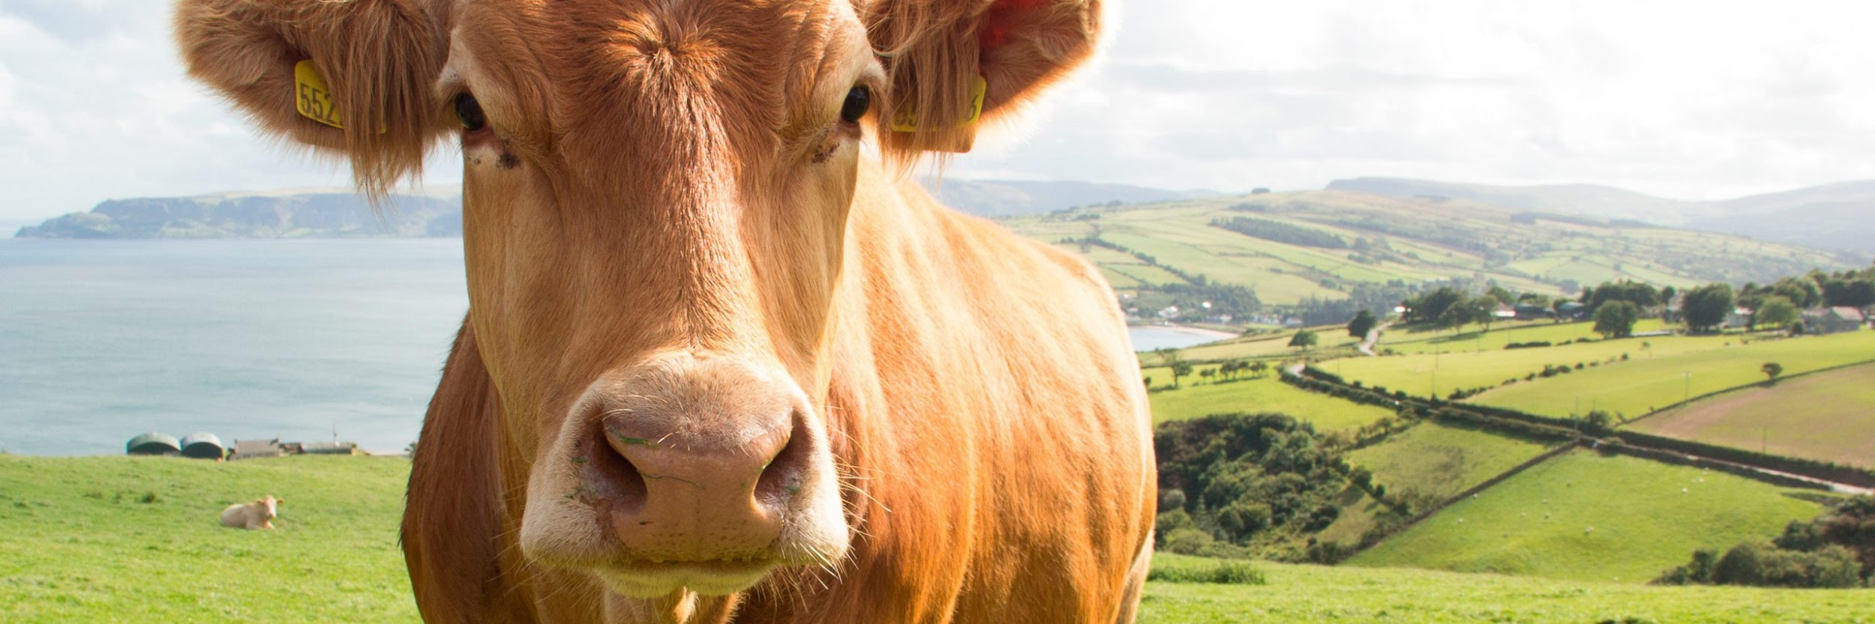

OPTIMIZATION OF ENERGY CONSUMPTION IN PRECISION LIVESTOCK FARMING USING IMAGE COMPRESSION ALGORITHMS

Slide 2

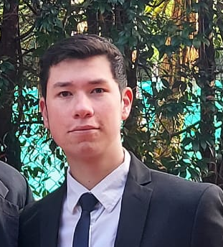
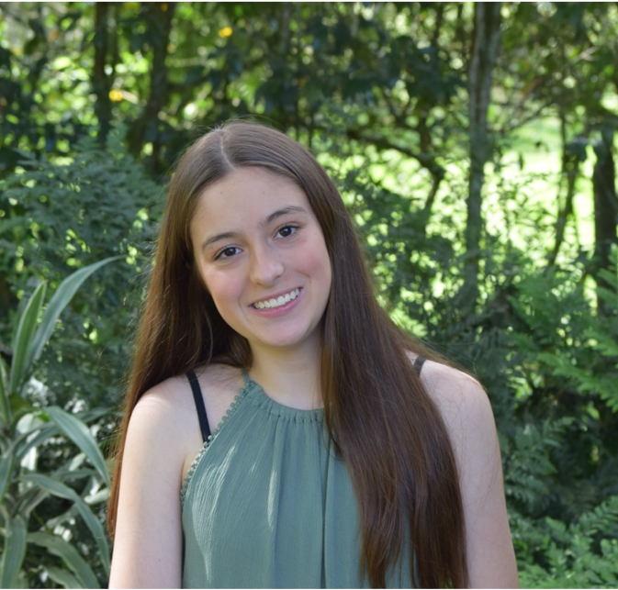
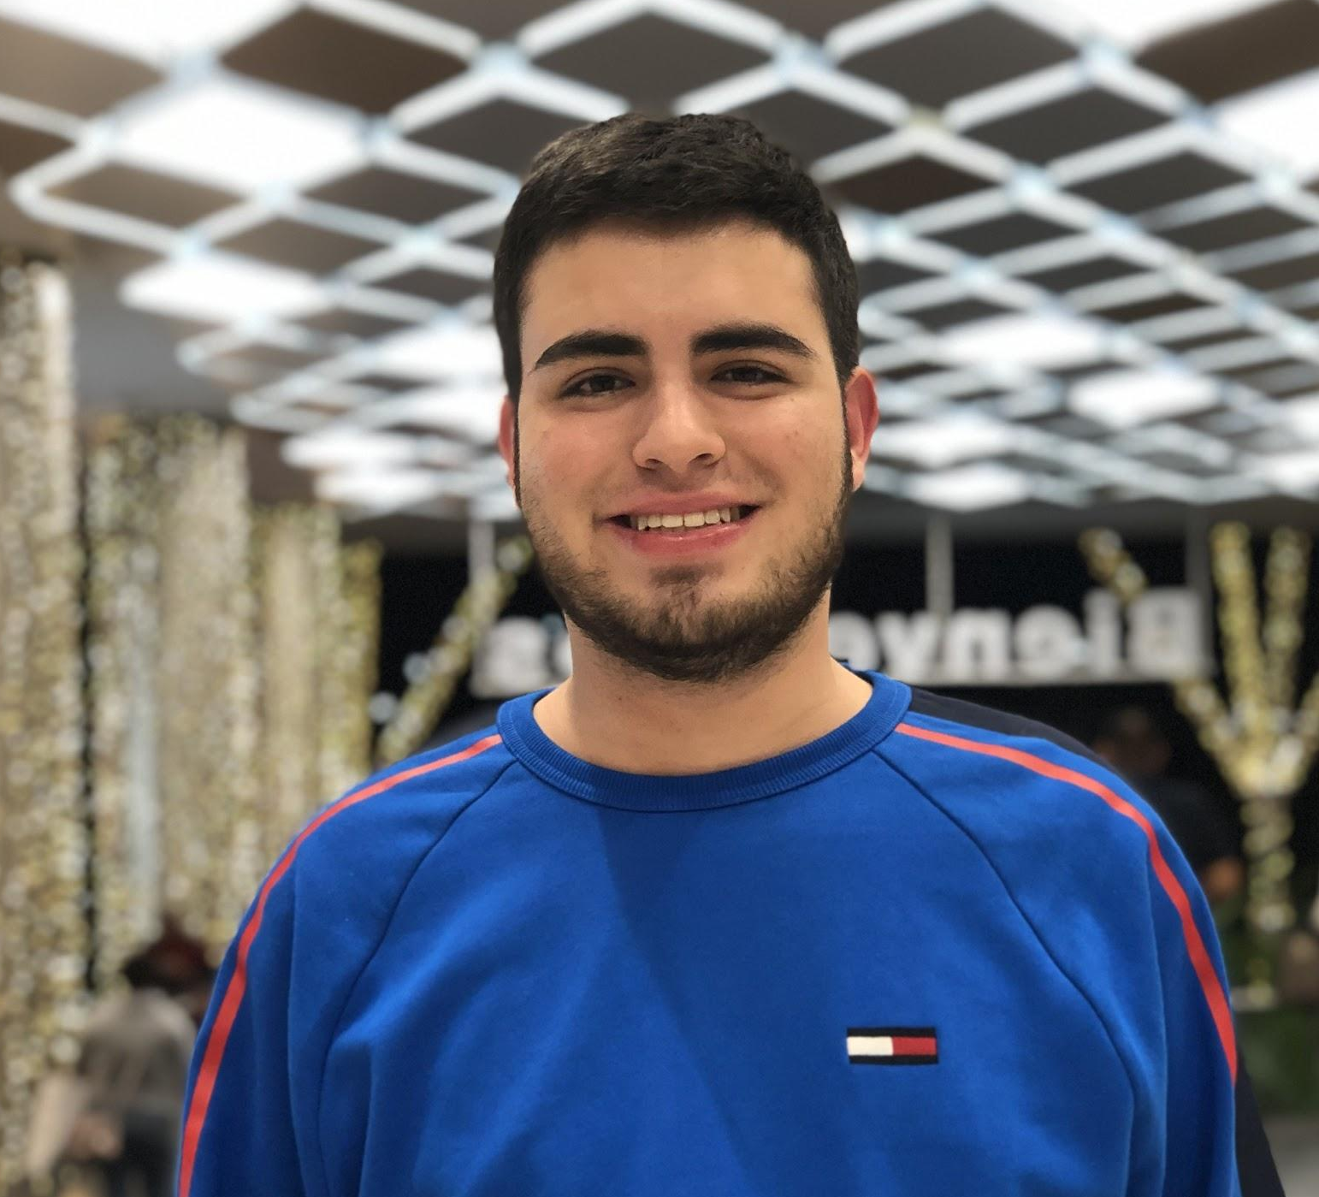
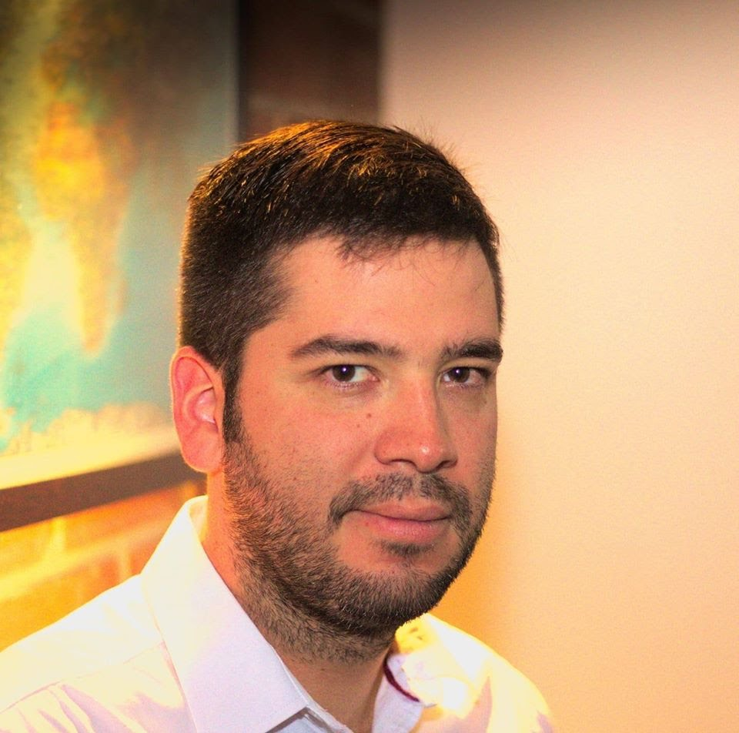

Team Presentation
Martín Ospina Uribe
María José Bernal Vélez
Simón Marín
Mauricio
Toro
https://github.com/mjbernalv/ST0245-001/tree/master/proyecto

Slide 3
THANK YOU!.

